Slide 1
The Dalles Dam Oil Spill Plan
Bob Cordie
Biologist
The Dalles Dam
May 2016 FPOM meeting

Slide 2
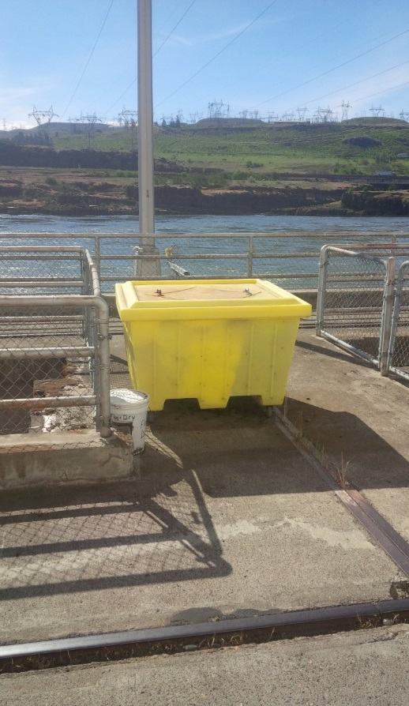
Spill Prevention, Control and Countermeasure Plan (SPCC)
Purpose; ‘to describe measures implemented by the The Dalles Dam to prevent oil discharges from occurring, and in the event of a discharge, prepare the facility to respond in a safe, effective, and timely manner’.
Covers; Oil storage, discharge potential, prevention measures, countermeasure response, equipment location, waste disposal, volumes, transfer requirements, training...

Slide 3
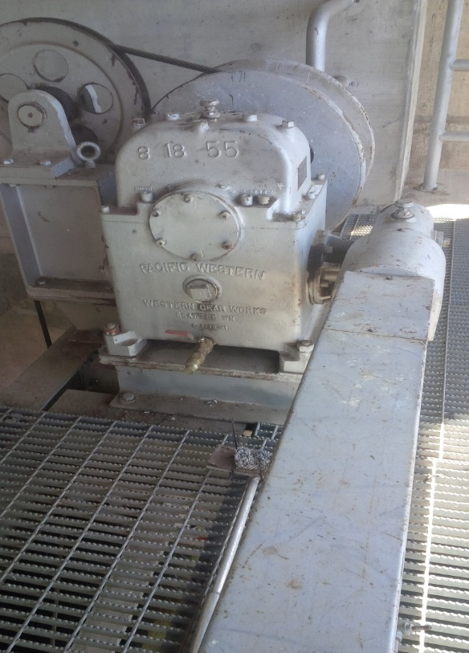
Oil Accountability Program
Includes;
Standing procedures
Oil/grease tracking and inventory
Valve locations
Oil applications
Training
Oil transfer
Equipment inspection program
Fisheries involvement on bi-weekly inspections of spillway, sluiceway and fishway equipment for any leakage.

Slide 4
Spill Response Team
Members from several on site COE sections to respond to oil spill in river.
Planning and drills for deploying containment and deflection booms in river.
Countermeasures for both internal and external spills.
Apply WA Department of Ecology Geographic Response Plan (GRP) and work in conjunction with state and federal agencies.

Slide 5
Fishladder Exit Permanent Boom
Increase of oil trains along Columbia river railways.
Purchased east fishway exit boom. Awaiting funding/opportunity
Boom plan previously coordinated with FPOM

